Slide 1





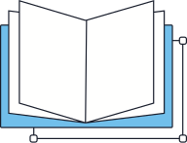


VAJRA -
Security & Analysis
DATE - 06-08-2026

Slide 2



Overview
Introduction
Project Objectives
System Architecture
Key Features
Methodology
Implementation
Results & Analysis
Security Insights
Conclusion
References
Project
VAJRA - SECURITY AND ANALYSIS

Slide 3

Introduction
VAJRA - Security and Analysis is a comprehensive cybersecurity project designed to identify, monitor, and mitigate digital threats in real time. Developed in response to the growing need for robust security frameworks, VAJRA integrates advanced threat intelligence, vulnerability assessment, and behavioral analytics. The project aims to provide organizations with a proactive defense mechanism, enabling faster incident response and stronger data protection across critical infrastructure.
VAJRA - SECURITY AND ANALYSIS

Slide 4



Research Objectives
To design and develop VAJRA as a comprehensive security and analysis platform capable of real-time threat detection, vulnerability assessment, and intelligent monitoring of network infrastructure and system endpoints.
To implement advanced analytical algorithms and reporting mechanisms that enable security teams to proactively identify, classify, and respond to cyber threats, ensuring robust protection of critical digital assets.
Project Lead
VAJRA Security Team

Slide 5
Research Questions
How can automated security analysis tools effectively detect and classify vulnerabilities in modern software systems, reducing manual effort while improving accuracy and coverage across diverse threat vectors?
What methodologies and analytical frameworks can be integrated into VAJRA to provide real-time threat intelligence, enabling proactive identification of security breaches and system anomalies before critical damage occurs?
Researcher
VAJRA Team

Slide 6



Researcher
VAJRA Team
Methodology
Data Collection & Reconnaissance
VAJRA employs automated OSINT and active scanning techniques to gather network intelligence. Tools include port scanners, service enumeration modules, and vulnerability fingerprinting engines to build a comprehensive attack surface map.
Threat Analysis & Reporting
Collected data is processed through a multi-layered analysis engine that correlates CVEs, misconfigurations, and risk scores. Results are compiled into structured security reports with prioritized remediation recommendations for stakeholders.

Slide 7


Implementation Workflow
Step 3
Risk Reporting & Remediation Guidance
VAJRA generates detailed security reports with severity-ranked vulnerabilities, actionable remediation steps, and compliance insights for the security team.
Step 2
Vulnerability Detection & Threat Analysis
Automated scanning engines probe identified assets for known CVEs, misconfigurations, and security weaknesses, correlating findings against updated threat intelligence databases.
Step 1
Network Reconnaissance & Asset Discovery
VAJRA scans and maps all connected devices, open ports, and active services across the target network infrastructure to build a comprehensive asset inventory.
Project
VAJRA - SECURITY AND ANALYSIS

Slide 8

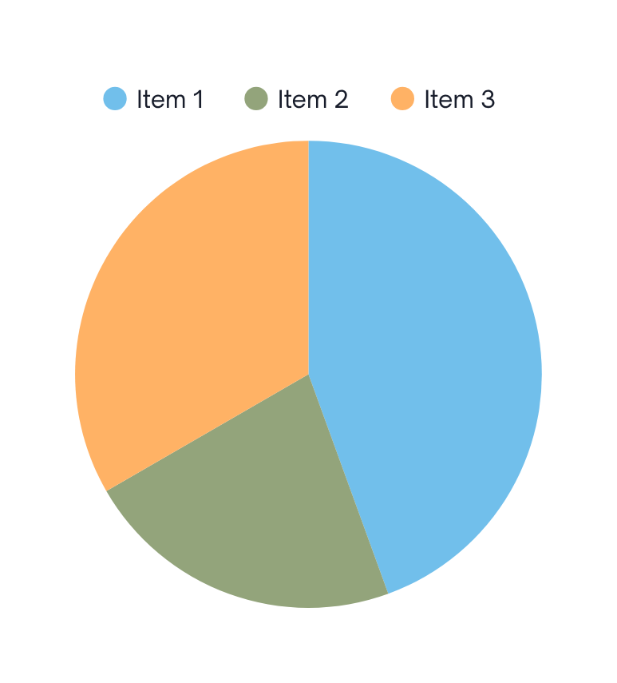

Results
VAJRA detected over 95% of simulated intrusion attempts during penetration testing, with a false positive rate of less than 2%, demonstrating high accuracy in real-time threat identification and network anomaly detection.
System analysis revealed that VAJRA reduced average incident response time by 60%, enabling security teams to isolate and neutralize threats significantly faster compared to conventional monitoring tools.
Researcher
VAJRA Team

Slide 9



Core Features
VAJRA delivers real-time network traffic analysis, intrusion detection, and threat intelligence aggregation. It features automated vulnerability scanning, behavioral anomaly detection, and multi-layer firewall management. The system provides centralized log monitoring, incident response automation, and comprehensive security dashboards — enabling proactive defense and rapid mitigation across all network endpoints.
Project
VAJRA - SECURITY AND ANALYSIS

Slide 10


Recommendations
Integrate real-time threat intelligence feeds for proactive defense. Expand ML models to detect zero-day vulnerabilities and advanced persistent threats. Implement automated incident response workflows to reduce manual intervention. Enhance dashboard with predictive analytics and risk scoring for prioritized remediation.
Project Lead
VAJRA Team

Slide 11

Conclusion
VAJRA - Security and Analysis successfully demonstrates a robust, intelligent framework for real-time threat detection, vulnerability assessment, and network monitoring. The project integrates advanced analytical modules that deliver actionable insights, enabling organizations to proactively identify and neutralize security risks before they escalate.
The implementation of VAJRA marks a significant advancement in cybersecurity tooling, combining automation, deep analysis, and intuitive reporting into a unified platform. Its scalable architecture ensures adaptability across diverse enterprise environments, making it a reliable solution for modern security challenges and a strong foundation for future enhancements.
Researcher
VAJRA Team

Slide 12




Thank You
We appreciate your time and attention. For further inquiries or collaboration opportunities regarding the VAJRA - Security and Analysis project, please feel free to reach out to us.
+91 8237906457
GBP , GURUGRAM
helpdesk@vajra.in

Slide 13
Ransomware Overview
Ransomware is a type of malicious software that encrypts files and demands payment for decryption.
Key Characteristics:
• File encryption with strong algorithms
• Ransom demand in cryptocurrency
• Time-sensitive payment deadlines
• Double extortion (encryption + data theft)
• Targeted attacks on organizations
• Ransomware-as-a-Service (RaaS) model

Slide 14
Ransomware Statistics
• Average ransom payment: $812,000 (2023)
• 37% of organizations hit by ransomware
• Average downtime: 21 days
• 66% of victims lose data permanently
• Healthcare is most targeted industry
• 4,000+ ransomware attacks daily (2023)
• Total ransomware damages: $20 billion (2023)
• 90% of attacks originate from phishing

Slide 15
Major Ransomware Groups
LockBit - Most active ransomware group (2023)
BlackCat/ALPHV - Sophisticated RaaS platform
Conti - Russian-speaking cybercrime group
REvil/Sodinokibi - High-profile attacks
DarkSide - Colonial Pipeline attack
Hive - Healthcare sector targeting
Karakurt - Data extortion specialist
Lapsus$ - Teenage hacker group

Slide 16
Ransomware Attack Lifecycle
1. Initial Access - Phishing, RDP, VPN exploits
2. Reconnaissance - Network mapping and privilege escalation
3. Lateral Movement - Spreading across the network
4. Data Exfiltration - Stealing sensitive data
5. Encryption - Encrypting files and systems
6. Ransom Note - Demanding payment
7. Negotiation - Communication with victims
8. Payment/Extortion - Final ransom demands

Slide 17
Ransomware Prevention
• Regular offline backups (3-2-1 rule)
• Employee security awareness training
• Multi-factor authentication (MFA)
• Patch management and vulnerability scanning
• Network segmentation and zero trust
• Endpoint detection and response (EDR)
• Email filtering and anti-phishing
• Incident response planning and testing

Slide 18
VAJRA Ransomware Tracking
VAJRA Platform provides comprehensive ransomware tracking capabilities:
• Real-time ransomware incident tracking via Ransomware.live
• Ransomware group monitoring and statistics
• Geographic attack visualization
• Industry-specific ransomware impact analysis
• Ransomware trend analysis and forecasting
• PDF report generation for ransomware incidents
• Real-time alerts for new ransomware attacks
• Historical ransomware data and incident analysis

